Slide 1

Strategies in English Academic Writing:
Indonesian Graduate Students’ Experiences at Hungarian Universities
Doctoral School Conference - 5
Dedy Subandowo
(A Third-year PhD Student)
Supervisor:
Csilla Sárdi, PhD
-----------------------------------------------------------
Doctoral School of Linguistics
Pázmány Péter Catholic University
Tuesday, 21th June 2022
Notes:
Explain the context of research design that this Interview is part of other data collection method and not the only method that I use for entire study.
I am planning to use mix method including interview and documentations as well as corpus analysis.
This is a pilot interview checklist
This pilot is to administer and develop the interview checklist before the final result is formatted.

Slide 2
Outline
1. Introduction
  1.1 Aim and research questions
2. Literature review
  2.1 The process of academic writing
  2.2 Academic writing strategies
  2.2.1 Definition of academic writing strategies
  2.2.2 Academic writing strategies in the literature
  2.2.3 A taxonomy of L2 English writing strategies
3. Research method
3.1 Participants
3.2 Research instrument
3.3 Data collection and analysis
4. Results and discussion
5. Conclusion
References
2

Slide 3
1. Introduction
Challenges for L1 and L2 speakers of English (e.g., academic writing)
Challenges for EFL/ESL students in higher education
complexity in academic writing
high-stakes assessments (e.g., essay assignments)
strategies in English academic texts
“No one is a native speaker of writing”
(Leki, 1992, p.10)
3
Notes:
A high-stakes test is any test used to make important decisions about students, educators, schools, or districts, most commonly for the purpose of accountability—i.e., the attempt by federal, state, or local government agencies and school administrators to ensure that students are enrolled in effective schools and being taught by effective teachers. In general, “high stakes” means that test scores are used to determine punishments (such as sanctions, penalties, funding reductions, negative publicity), accolades (awards, public celebration, positive publicity), advancement (grade promotion or graduation for students), or compensation (salary increases or bonuses for administrators and teachers).
Formative and Summative assessments:
Formative assessments have low stakes and usually carry no grade, which in some instances may discourage the students from doing the task or fully engaging with it. The goal of summative assessment is to evaluate student learning at the end of an instructional unit by comparing it against some standard or benchmark.

Slide 4
1.1 Aim and research questions
Aim:
To examine English academic writing strategies utilized by Indonesian graduate students at Hungarian universities focusing on an interview checklist
Research questions:
What types of writing strategies do Indonesian graduate students use in their academic essays?
What types of strategies from the interview checklist are frequently employed by the students?
4
Notes:
Justification

Slide 5

2. Literature review
2.1 The Process of academic writing
Research to gather data
Pre-writing
First-draft
Revise
Editing
Sharing
Johnson, A. P. (2016). Academic writing: Process and product. Rowman & Littlefield. Chicago
5
Notes:
Explicitely knowledgable – awareness in relation to conscious

Slide 6
2.2 Academic writing strategies
2.2.1 Definition of academic writing strategies
Definition :
“Thoughts and actions consciously chosen and operationalized by writers in order to make their writing more efficient” (based on Cohen’s definition of learner strategies, 2014, p.7-8).
Cohen, A. D. (2014). Strategies in learning and using a second language. In Strategies in Learning and Using a Second Language. https://doi.org/10.4324/9781315833200
6

Slide 7
2.2.2 Academic writing strategies in the literature
Types of academic writing strategies :
Cognitive strategies (e.g., revising grammar)
Backtracking (e.g., rereading)
Seeking tutor support
Teachers’ feedback
The use of exemplary academic essays
Metacognitive strategies :
Planning, monitoring, and evaluation
Preparing and planning questions at the beginning of writing, while, and after writing
Mazgutova and Hanks (2021)
Munoz-Luna (2015)
Xia (2017)
Hu (2022)
Zhao & Liao (2021)
Writing strategies in L2 academic writing:
Metacognitive strategies (e.g., planning, monitoring)
Cognitive strategies (e.g., summarising, paraphrasing)
Comprehension strategies (re-reading)
Socio-affective stratgies (e.g., cooperative planning)
Cognitive and affective strategies :
Planning
Execution
monitoring
Revising
Enjoyment vs anxiety
Metacognitive strategies : task interpretation, planning, translating, evaluating & monitoring, and revising
7

Slide 8
2.2.3 A Taxonomy of L2 English Writing Strategies
Rhetorical strategies:
Presenting the idea in writing convention
Meta-cognitive strategies:
Controlling the writing process
Cognitive strategies:
Implementing the actual process of writing actions
Communicative strategies:
﻿expressing ideas in a more effective way
Social/affective strategies:
Interacting with others for clarification, feedback, or motivation
Mu, C. (2005). A Taxonomy of ESL Writing Strategies. Proceedings Redesigning Pedagogy: Research, Policy, Practice, p.9.
8
Notes:
What did I use this taxonomy?
Strategies by functions
Rhetorical strategies :
﻿the strategies that writers use to organise and to present their ideas in writing conventions acceptable to native speakers of that language.
Organization
Use of L1
Formatting/modelling
Comparing
Metacognitive writing strategies, correspondingly, involve thinking about the writing process, its planning, monitoring, and self-evaluating of what has been written. More explicitly, via the skills of planning, monitoring, and evaluating the writer manages, directs, regulates and guides his/her writing production.
Metacognitive strategies : focus on monitoring vocabularies wheter there are vocabulary that overuse or repetition
﻿that writers use to control the writing process consciously.
Planning
Monitoring
Evaluating
Cognitive strategies
﻿the strategies that writers use to implement the actual writing actions.
Generating ideas
Revising
Elaborating
Clarification
Retrieval
Rehearsing
Summarizing
Communicative strategies : ﻿those that writers use to interact with others to clarify some questions and to regulate emotions, motivation, and attitudes in the writing.
Avoidance
Reduction
Sense of readers

Slide 9


No | Pseudonym (Gender) | Faculty | Program | IELTS/CEFR | University
1 | Ani (F) | Social Science and International Relations | International Relations | 6.5/ B2 | Corvinus
2 | Bambang (M) | Faculty of Economics | Supply Chain Management | 6.0/B2 | Széchenyi István, Győr
3 | Budi (M) | Faculty of Social Sciences | Regional and Environmental Economic Studies | 6.0/B2 | BME
4 | Eko (M) | Social Science and International Relations | International Relations | 7.5/C1 | Corvinus
5 | Lilis (F) | Faculty of Economics and Business Administration | International Economy and Business | 7.0/C1 | Szeged
6 | Novi (F) | Faculty of Social Sciences | Regional and Environmental Economic Studies | 7.5/C1 | Corvinus
7 | Rina (F) | Faculty of Humanities and Social Sciences | Human Resources Counceling | 7.0/C1 | Pécs
8 | Sri (F) | Faculty of Economic and Business | Business Development | 6.5/B2 | Pécs
9 | Triono (M) | Social Science and International Relations | Regional and Environmental Economic Studies | 7.5/C1 | Corvinus
10 | Yanti (F) | Faculty of Social Sciences | Sociology | 6.5/B2 | ELTE
3. Research Method
3.1 Participants
9

Slide 10


Interview checklist
3.2 Research instrument
Excel sheet
16 questions
Answers (yes =✓, no = x)
Questions (the process of writing)
10

Slide 11

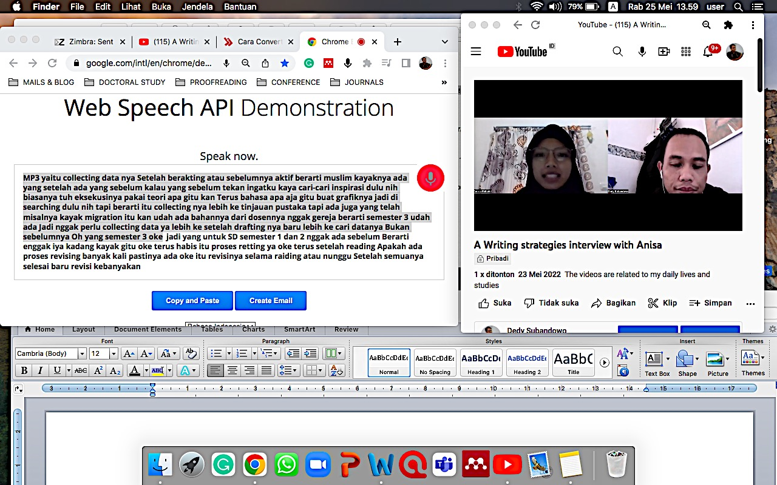

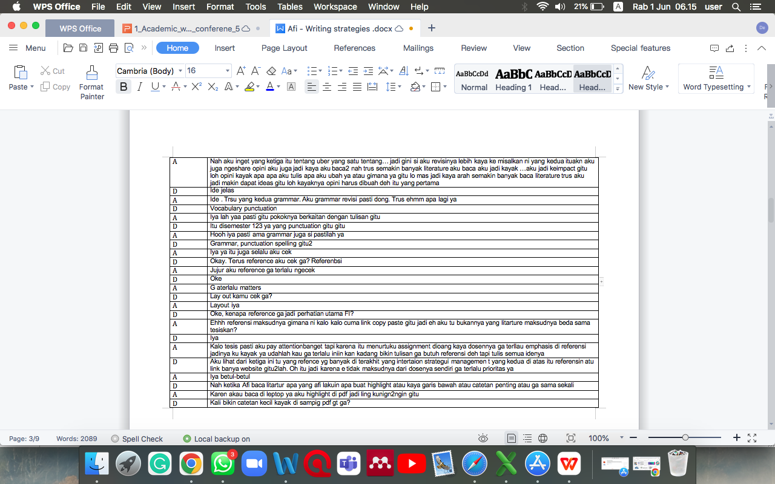
Interviewing
3.3 Data collection and data analysis
Transcribing
Writing strategies with Sri
11
Notes:
Validated

Slide 12
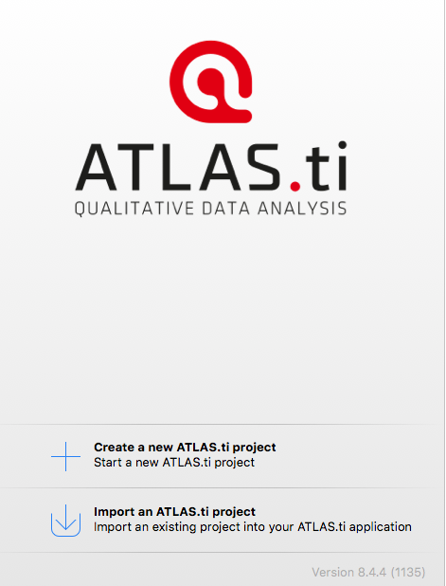
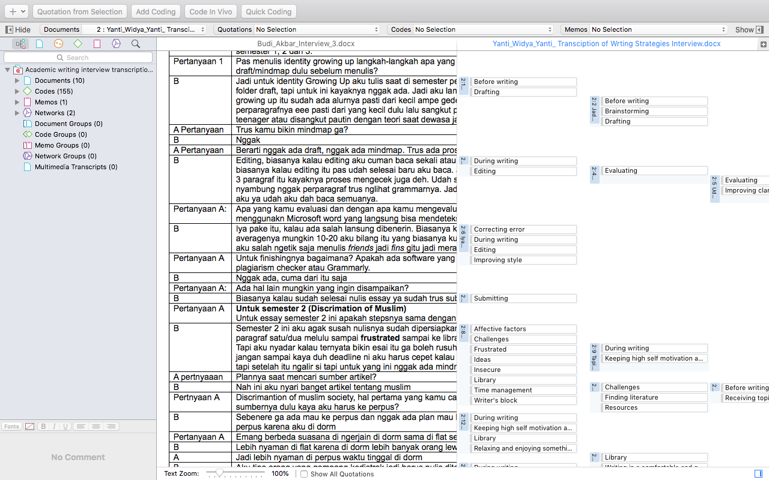
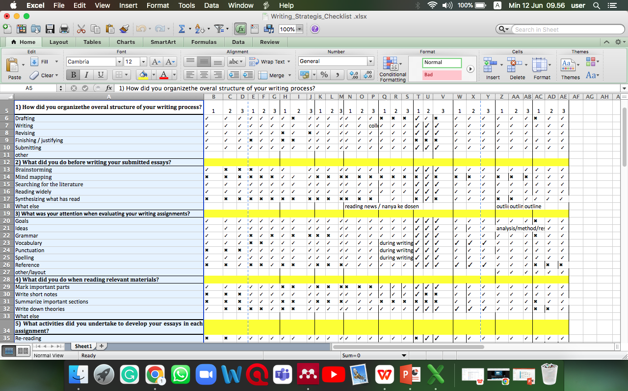
Coding
Quotations
10 documents
570 quotations
155 codes
Checklist
Data analysis
12

Slide 13
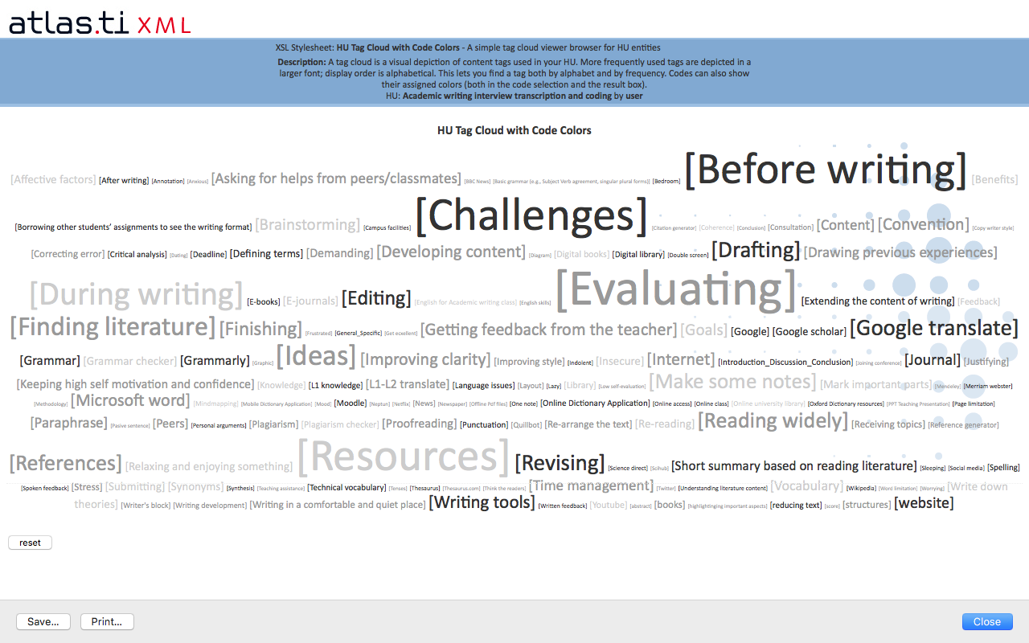
Tag cloud
37 types of writing strategies
Rhetorical = 4
Metacognitive = 5
Cognitive = 9
Communicative = 5
Social = 12
Affective = 2
13

Slide 14
4. Results and discussion
4.1 Indonesian graduate students’ English academic writing strategies
Planning
Evaluating
Revising
Finishing
Developing content:
Digital resources
Writing tools
Internet
Moodle
Double screen mode
PPT class materials
Rhetorical Strategies
Metacognitive
strategies
Convention
Layout
Writing structure: Introduction_Discussion_Conclusion
Page limitation
14

Slide 15
Cognitive strategies
Linguistic issues :
paraphrasing
defining terms
basic grammar rules
technical vocabulary
finding synonyms
correcting error/punctuation/spelling
tenses
passive forms
Translating
Proofreading
Rereading
Personal arguments
Diagram
Graphic
Literature review:
  reading widely
  making some notes
  short summary based on reading literature
  highlighting important parts
  synthesizing
  Annotating
  Writing down theories
  Generating ideas:
  mind mapping
  brainstorming
  drawing previous experience
  using L1 knowledge
15

Slide 16
Communicative strategies
Social strategies
Re-arrange the text
reducing text
Extending the content of writing
Improving style
Improving clarity
Getting feedback from the teacher
Asking for helps from peers/classmates
Writing in a comfortable and quiet place
Borrowing other students’ assignments to see the writing format
Consultation
English for Academic Writing Class enrollment
Writing in comfortable and quiet places (e.g. library, coffee café, bedroom)
Campus facilities
Signing up an online English class
Copying writer style
Joining conference
Thinking about the readers
16

Slide 17
Affective strategies
Keeping high self motivation and confidence
Relaxing and enjoying something :
watching Netflix
sleeping
going out with friends
17

Slide 18
4.2 The frequency of Indonesian graduate students’ L2 English academic writing strategies
Academic writing strategies | Frequency
Metacognitive | 471
Cognitive | 286
Social | 79
Communicative | 55
Rhetorical | 40
Affective | 28
Total | 959
Indonesian graduate students used more metacognitive strategies than other types of academic writing strategies.
18

Slide 19
The most occurrence of academic writing strategies
Evaluating
Finding resources
Planning
Revising
Translating
Reading widely
Making notes
Finishing
Writing tools
Improving clarity
19

Slide 20
Academic writing strategies in the process of writing
Planning |  |  |  | Drafting | Writing | Evaluating |  | Finishing
Receiving topics | Searching for literature | Reading widely | Generating ideas |  |  | Editing | Revising
Consultation with the teacher/ peers, borrowing other students’ assignments to see the writing format | E-journal, E-books, Digital library, Website, news, Google scholar, Science direct, Wikipedia, social media (e.g., Twitter & Youtube) | mark important parts, make short summary from literature , | brainstorming mind mapping | layout, make some notes, synthesizing what has been read, writing convention | Microsoft word, Google translate (L1-L2/L2-L1), Online dictionary (e.g., Webster, thesaurus, Oxford, mobile dictionary), synonyms and paraphrasing, drawing previous experiences, writing down theories, defining terms, using L1 knowledge | Employing writing software (e.g., Grammarly, Quillbot) correcting error, spelling, punctuation grammar, reducing and extending the content of writing, re-arranging the text | ideas, clarity, plagiarism, goals, vocabulary, references | Generating references (e.g., Mendeley, Microsoft office), proofreading with writing tools (e.g., Moodle, Grammarly), re-reading, Submitting
 |  |  |  |  | Relaxing and enjoying something (e.g., watch Netflix) keeping high self motivation and confidence writing in a comfortable and quiet place (e.g., library, café, bedroom)
20
Notes:
I still consider to use this slide yet I have no idea what to say about the slide in connection with the two research questions

Slide 21

Q1: Indonesian graduates students‘ L2 English academic writing :
Metacognitive strategies
Cognitive strategies
Social strategies
Communicative strategies
Rhetorical strategies
Affective strategies
5. Conclusion
Implications :
Further investigation in relation to the process of writing and academic writing strategies (e.g. evaluating, revising)
Q2: The most frequent type of academic writing strategies utilized by the students:
Evaluating, finding resources, planning, revising, translating, reading widely, making notes, finishing, writing tools, improving clarity
21
Notes:
Put in order Q1

Slide 22
References
Cohen, A. D. (2014). Strategies in learning and using a second language. In Strategies in Learning and Using a Second Language. https://doi.org/10.4324/9781315833200
Johnson, A. P. (2016). Academic writing: Process and product. Rowman & Littlefield. Chicago
Leki, I. (1992). Understanding ESL Writers: A guide for teachers. Portsmouth, New Hampshire: Boynton/Cook Publishers
Mazgutova, D., & Hanks, J. (2021). L2 Learners’ Perceptions of Their Writing Strategies on an Intensive EAP Course. Journal of Academic Writing, 11(1), 45–61. https://doi.org/10.18552/joaw.v11i1.566
Munoz-Luna, R. (2015). Main ingredients for success in L2 academic writing: Outlining, drafting and proofreading. PLoS ONE, 10(6), 1–15. https://doi.org/10.1371/journal.pone.0128309
Mu, C. (2005). A Taxonomy of ESL Writing Strategies. Proceedings Redesigning Pedagogy: Research, Policy, Practice, 1–10.
Hu, N. (2022). Investigating Chinese EFL Learners' Writing Strategies and Emotional Aspects. LEARN Journal: Language Education and Acquisition Research Network, 15(1), 440-468.
Xia, T. (2017). Application of Metacognitive Strategies in EFL Writing Instruction. 142(Icelandic), 159–165. https://doi.org/10.2991/icelaic-17.2017.35
Zhao, C. G., & Liao, L. (2021). Metacognitive strategy use in L2 writing assessment. System, 98, 102472. https://doi.org/10.1016/j.system.2021.102472
22

Slide 23

THANK YOU

